Slide 1
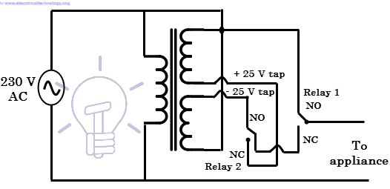

Slide 2
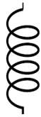


Input AC signal
Tap 1
Tap 2
Relay 2
Relay 1
To
Appliance

Slide 3
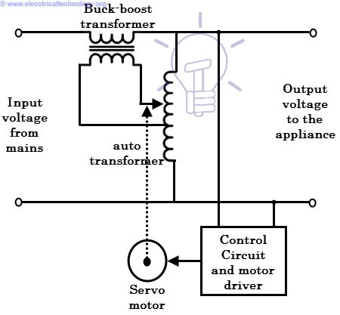

Slide 4
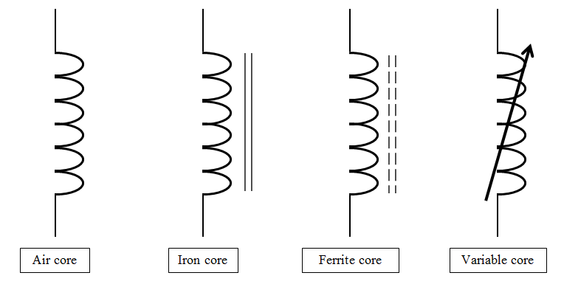
Buck Boost Transformer
To
Appliance
Input AC signal
o
Control Circuit and Motor Driver
Servo Motor

Slide 5
Buck Boost Transformer
IGBT Bridge or AC-AC Converter
To
Appliance
Input AC signal
Micro processsor or DSP based PWM generator

